Slide 1
8 B
A HOUSE WITH A HISTORY

Slide 2

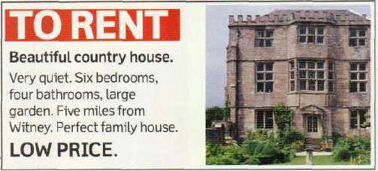
An advertisement
Cover the adverstisement. What can you remember about the house? Provide as many details as you can.
Yes, I would.
No, I wouldn’t because…

Slide 3
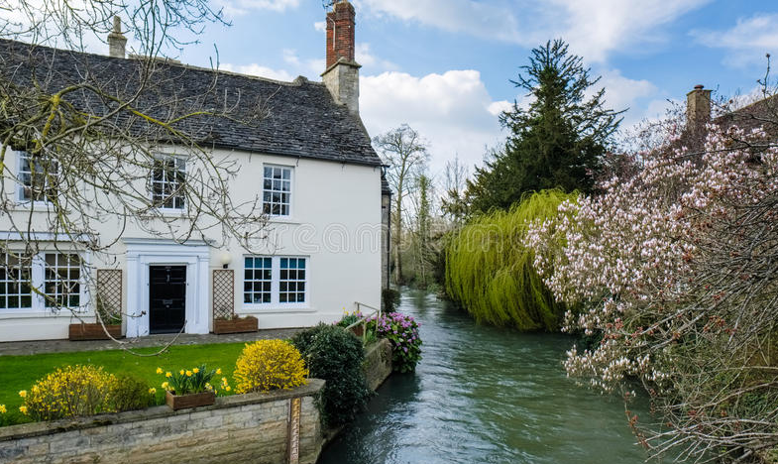

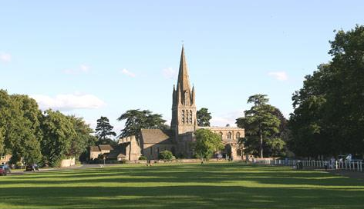
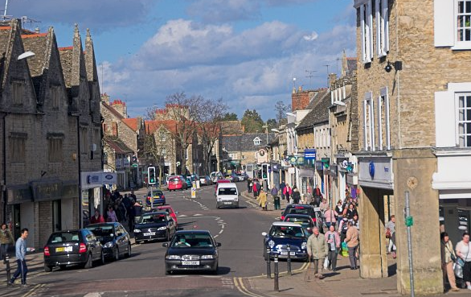
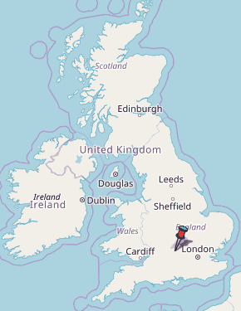

Slide 4
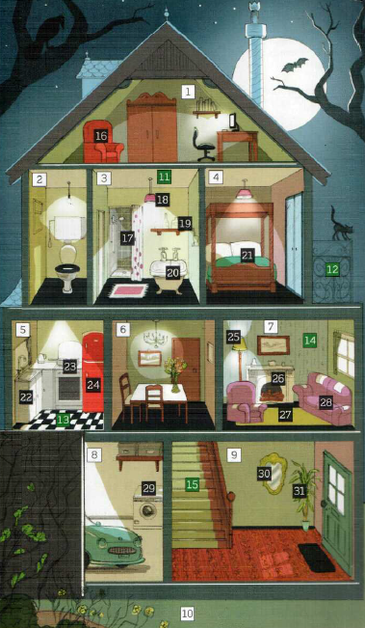

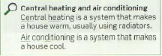
Page 161

Slide 5
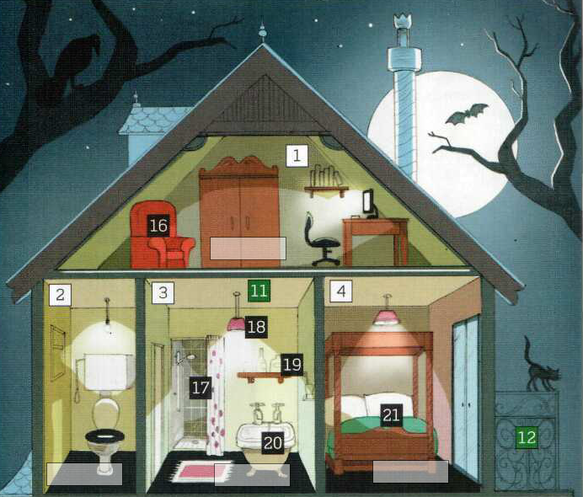
A study
A toilet
A bathroom
A bedroom

Slide 6
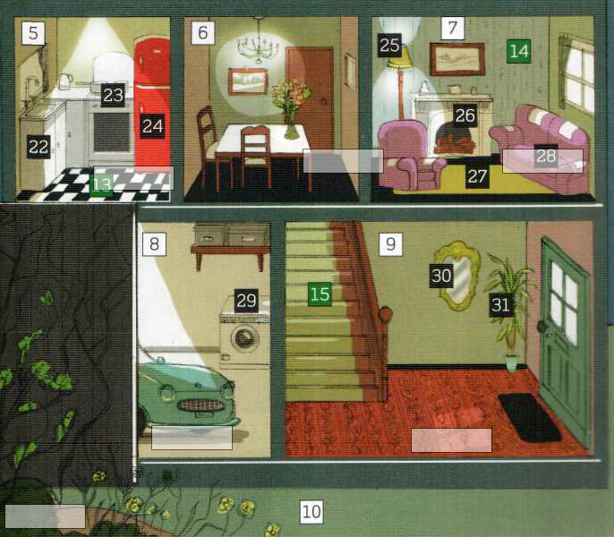
A dining room
A living room
A kitchen
a garage
A hall
A garden

Slide 7
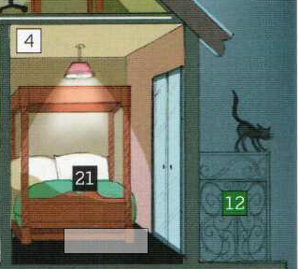
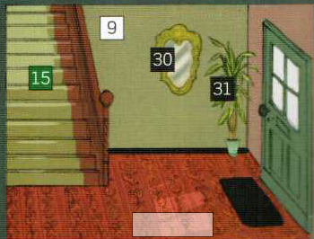
The ceiling
A light
A wall
A mirror
The stairs
A plant
A door
A bed
A balcony
A mat
The floor
The floor

Slide 8
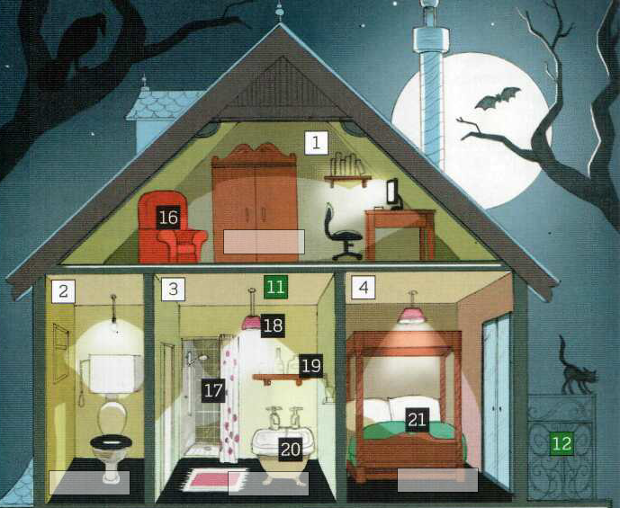
The roof
A chimney
A shelf
An armchair
A cupboard
A desk
The cistern
a shower
pillows
A bath
The toilet
A mat
A bed cover

Slide 9
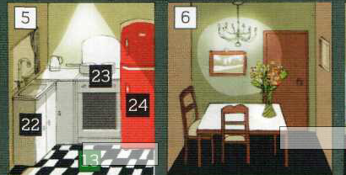
A light
A light
A picture
The worktop
A cooker
The sink
A vase
A fridge
a cupboard
A table
A chair
The floor

Slide 10
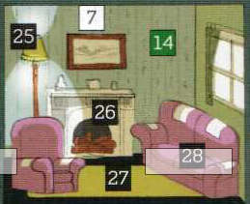
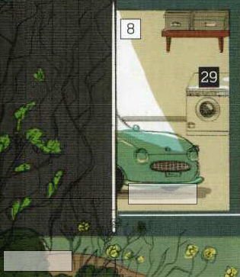
A picture
A shelf/shelves
A lamp
A window and curtains
A washing machine
ornaments
A fireplace
A car
An armchair
A sofa
A carpet
A flower bed

Slide 11

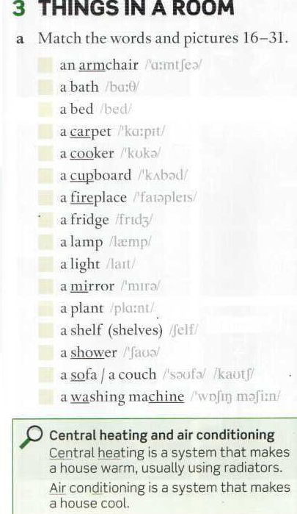
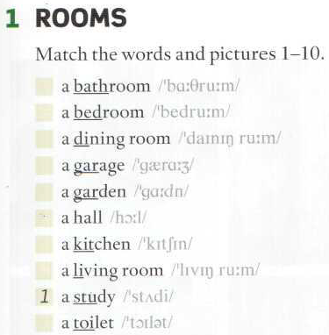
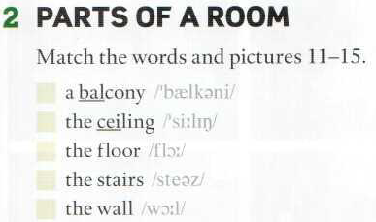
Page 161

Slide 12
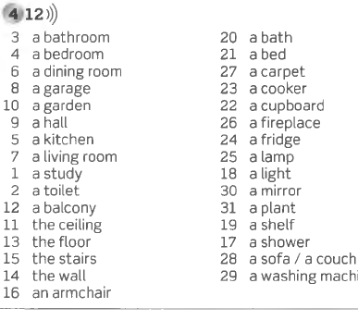
Key to exercise pag 161

Slide 13
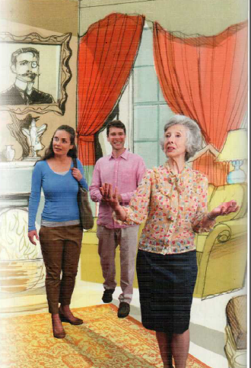
Read the introduction to the Listening at page 62 and answer these questions:
Who are Kim and Leo?
Where are they from?
Why are they there?
Did they read the advertisement?
Who is the old lady? She is the owner of the house.
What room is this?
What can you see in the room? (name everything you know!)
Is there a fireplace?
Kim and Leo are a young couple from the USA. They want to rent the house.

Slide 14
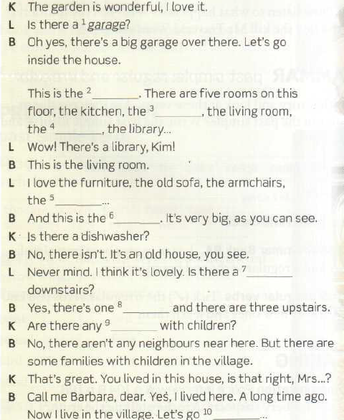
Listen to 4.13 and complete

Slide 15
Downstairs
Listen to 4.14 page 62
hall
Dining room
study
fireplace
kitchen
bathroom
downstairs
neighbours
upstairs

Slide 16
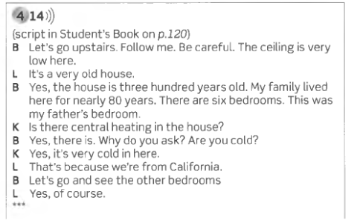
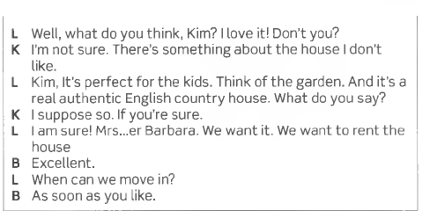
Pay attention to the information about the following:
The ceiling
The age of the house
The bedrooms
Her father´s bedroom
Central Heating
Kim’s opinion
Leo´s opinion
Do they want to rent it?
upstairs
1. The ceiling is very low. Leo bumps his head against it.
2. The house is three hundred years old.
3. There are six bedrooms upstairs.
4. It’s very cold in her father’s bedroom.
5. There is central heating.
6. There is something she doesn’t like.
7. He loves it.
8. Yes, they do.

Slide 17
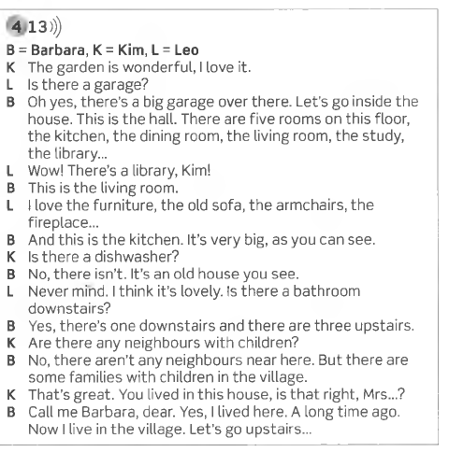
Upstairs
Downstairs
Kim and Leo’s decision

Slide 18
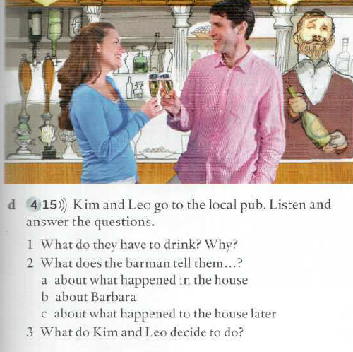
Listen to 4.15 and answer the questions
1. They have champagne because they want to celebrate their new house
a. That a man, Mr Travers, was murdered in the house in 1958
b. That she never married. Some people thought that she murdered her father.
c. That they tried to sell the house but nobody wanted to buy it.
3. They don’t want to sleep in the house. They decide to go to a hotel.

Slide 19
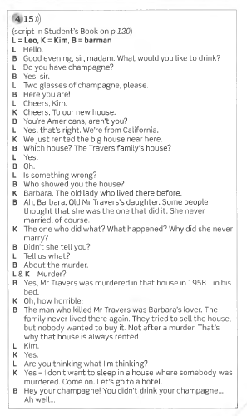
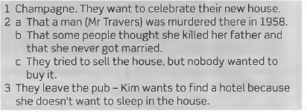
At the local pub

Slide 20
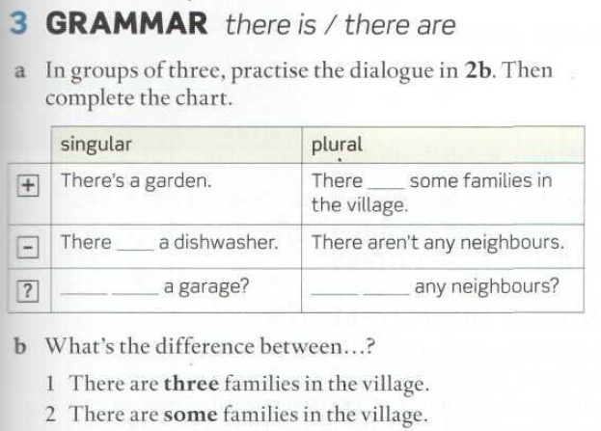
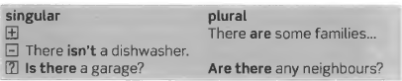
are
isn’t
Is there
Are there

Slide 21
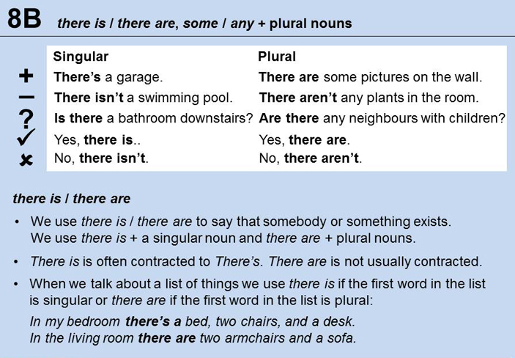
There is
There are

Slide 22
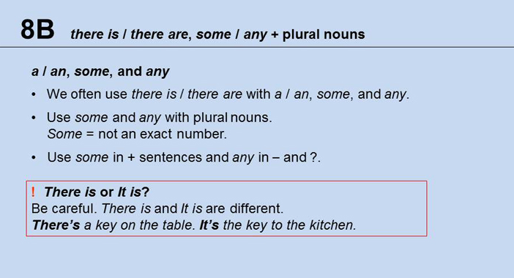
a / an
some
any
Hay una llave sobre la mesa.
Es la llave de la cocina.
TRANSLATE THESE SENTENCES

Slide 23
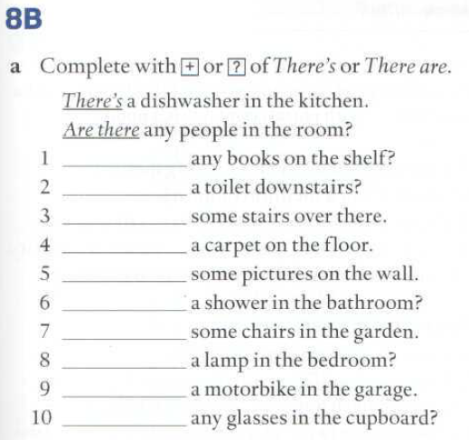
139
Are there
Is there
There are
There is
There are
Is there
There are
Is there
There is
Are there

Slide 24
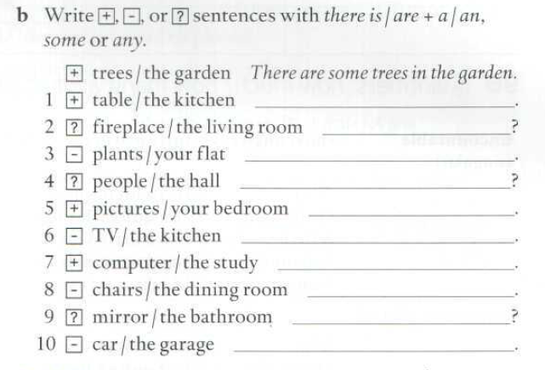
139
in
There is a table in the kitchen.
Is there is a fireplace in the living room?
There aren’t any plants in your flat.
Are there any people in the hall?
There are some pictures in your bedroom.
There isn’t a TV in the kitchen.
There is a computer in the study.
There aren’t any chairs in the dining room.
Is there is a mirror in the bathroom?
There isn’t a car in the garage.

Slide 25
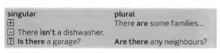
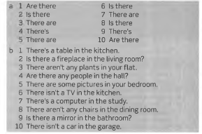
Keys to exercises

Slide 26
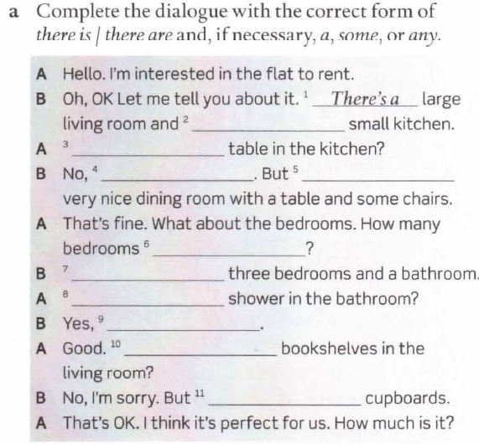
WORKBOOK PAGE 52
there Is a
Is there a
there isn’t
there is a
are there
There are
Is there a
there is
Are there any
there are some

Slide 27
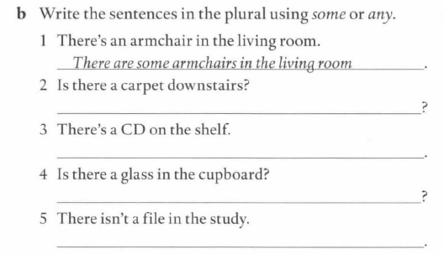
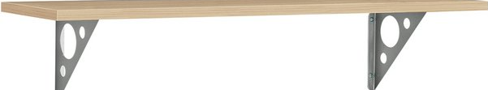
WORKBOOK PAGE 52
on
2 Are there any carpets downstairs?
3 There are some CDs on the shelf.
4 Are there any glasses in the cupboard?
5 There aren't any files in the study.

Slide 28
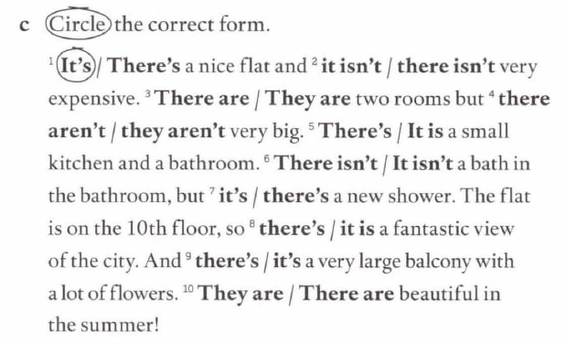
WORKBOOK PAGE 52

Slide 29
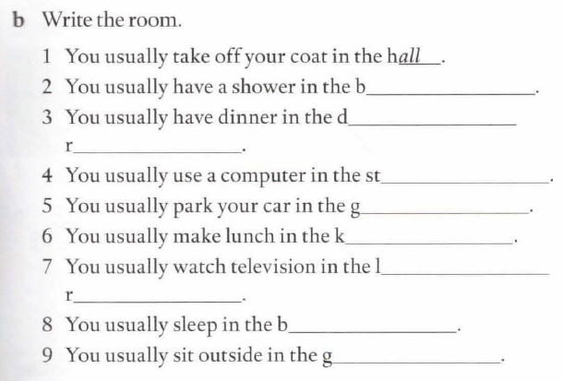
WORKBOOK PAGE 53
bathroom
dining
room
study
garage
kitchen
Living room
bedroom
garden

Slide 30
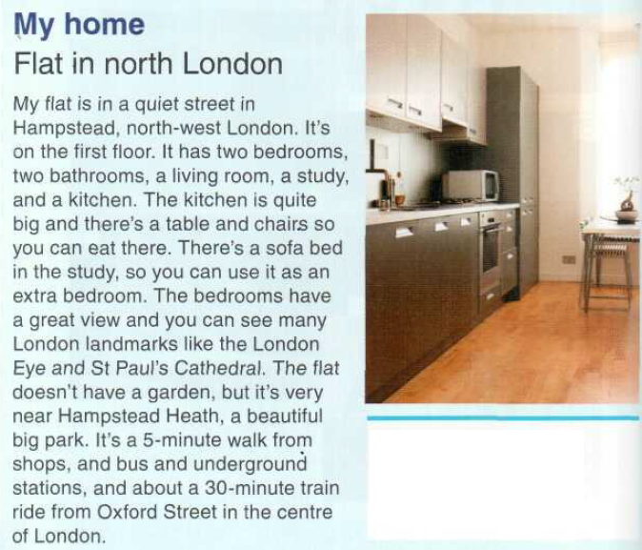
Some cupboards
A fridge and a freezer
The worktop
A microwave
A table and some chairs
Page 114

Slide 31
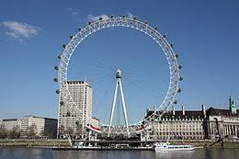
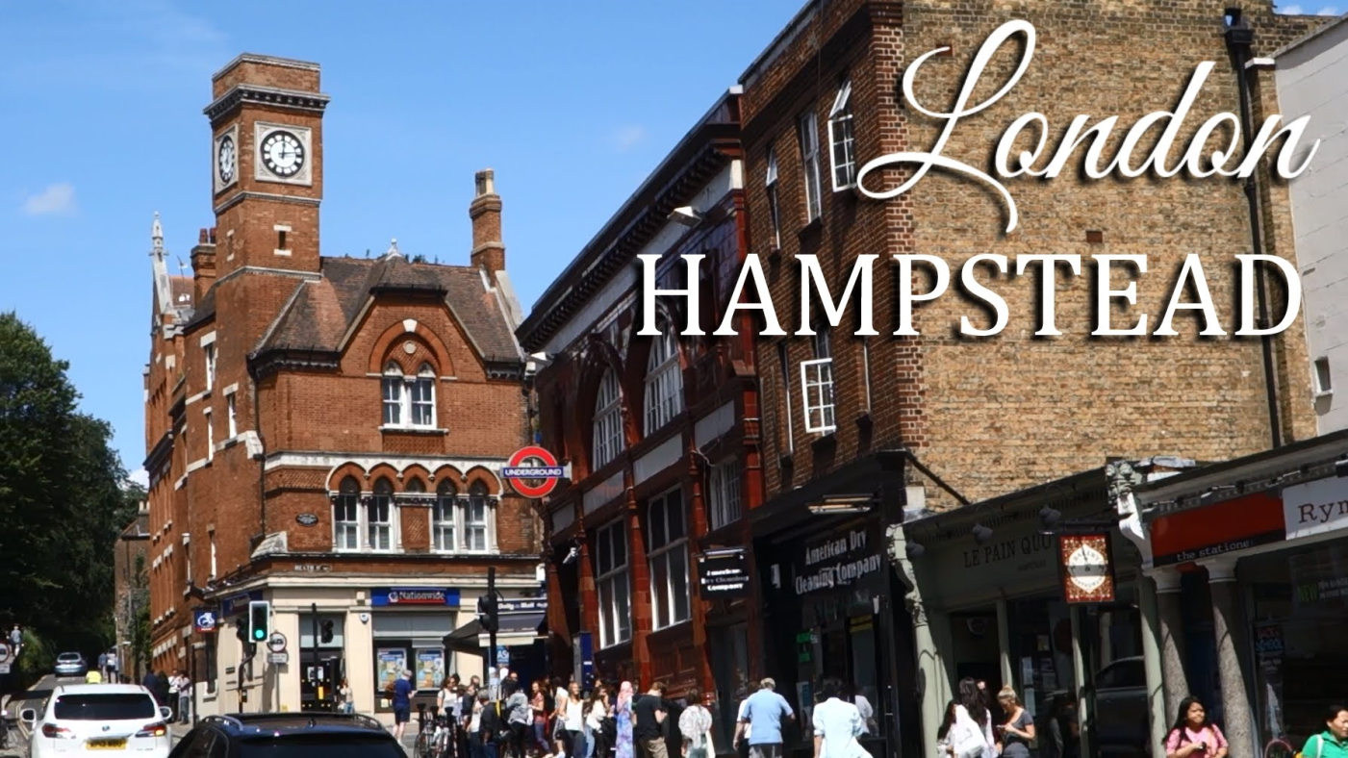
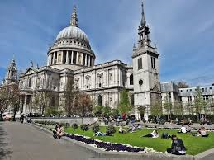
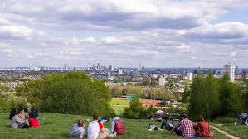
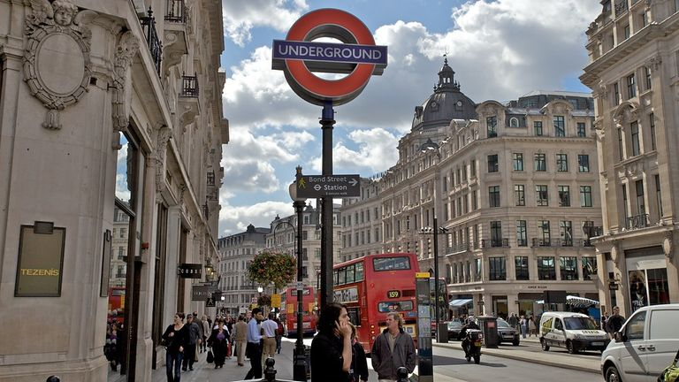
The London Eye or (an observation wheel)
Saint Paul’s Cathedral
Hampstead Heath (a beautiful park)
The underground

Slide 32
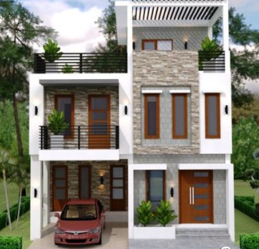
Write about your house or flat
Where is it?
What floor is your flat on?
What rooms are there?
Give details about some of the rooms.
What can you see from the windows?
What services are there nearby?
How far is it from the city center? / from a shopping mall? / a park?, the university?, etc.
in
on
on
Written assignment

Slide 33
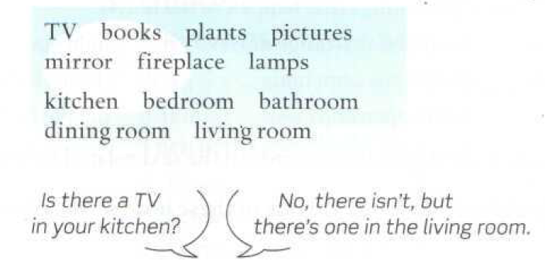

Slide 34
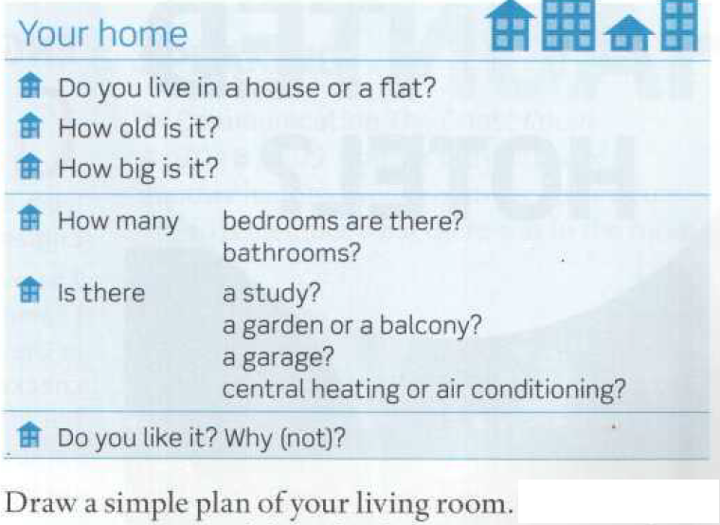

Slide 35
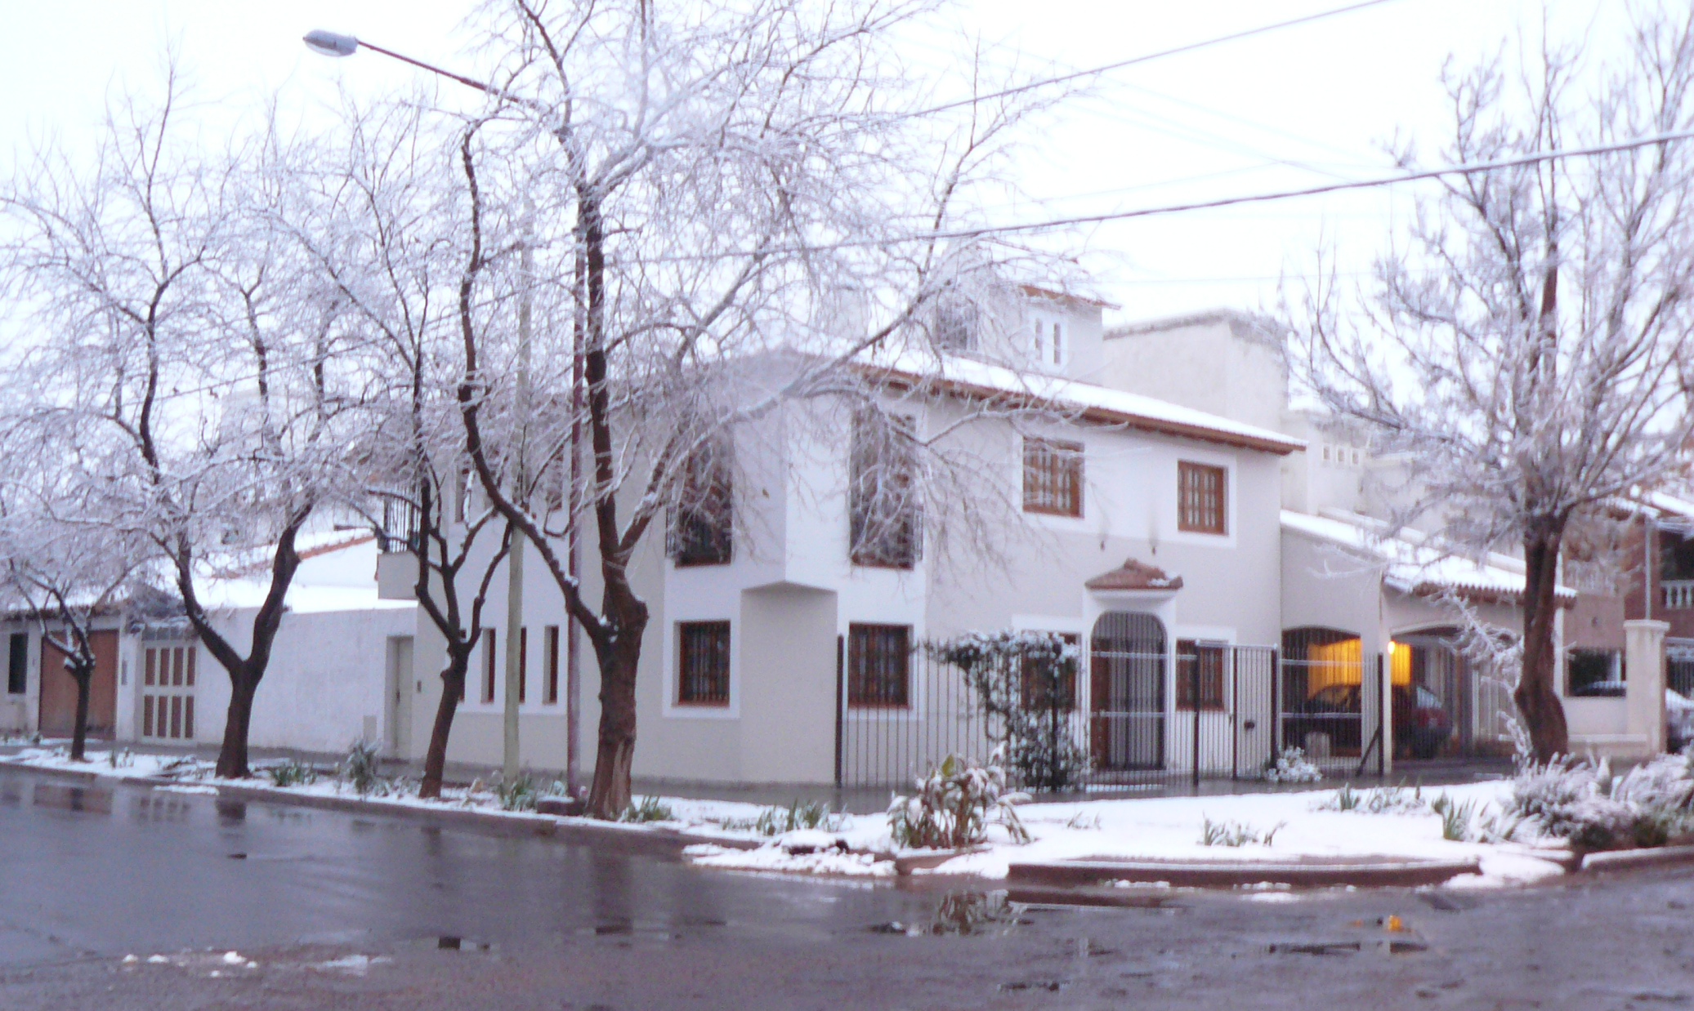

Slide 36


Slide 37


